Slide 1
F5 Automation Toolchain
Application Services 3 Extension
Stephen Archer
f5 Senior Solutions Engineer – Cloud & Automation

Slide 2
Notes:
Early examples of automation: routing protocols, SNMP polls/traps, telnet/expect scripts.

Slide 3
Automation 101
Virtual Session 1
Stephen Archer
Sr. Solution Engineer – Cloud/DevOps
June 10, 2020

Slide 4
Automation Concepts

Slide 5
RESTful API
API
noun Computing
a set of functions and procedures that allow the creation of applications which access the features or data of an operating system, application, or other service.
RESTful API
a REST API uses HTTP URIs and Methods (POST, GET, PUT DELETE) to Create, Read, Update, and Delete (CRUD)
GET to obtain /some/resource
POST to modify /some/other/resource
Notes:
Early examples of automation: routing protocols, SNMP polls/traps, telnet/expect scripts.

Slide 6
Non-Idempotent Operations
Multiple identical requests can produce errors…
Transaction 1
Configuration
Create Object A
Object A

Slide 7
Non-Idempotent Operations
Multiple identical requests can produce errors…
Transaction 2
Configuration
Create Object A
Object A
50x ERROR
Object already exists
Create Object B
Create Object C

Slide 8
Idempotent Operations
Multiple identical requests are handled sensibly…
Transaction 3
Configuration
Create Object A
No Change Needed
Object A
Create Object B
Object B
200 OK Success
Create Object C
Object C
200 OK Success

Slide 9
Atomic Transactions
Partially Committed
Committed
Begin
Preparing
Roll-Back
End
Failed
Aborted

Slide 10
Imperative Operations
Domain specific knowledge required to deploy a…
Virtual
Server
HTTP Profile
SNAT Profile
Pool
Monitor
Client TCP Profile
Server TCP Profile
Node
Client SSL Profile
Certs
Server SSL Profile
Node
Key
Node

Slide 11
Declarative Operations
Easy to deploy…
Virtual
Server
You worry about this stuff… I don’t care. Just give me a Virtual Server.

Slide 12
f5 Automation Toolchain

Slide 13
F5 Automation Toolchain
Deploy
App Services
Monitoring /
Telemetry
Bootstrap
Onboard
CLOUD TEMPLATES &
CLOUD-INIT
Start BIG-IP instances in Public & Private Clouds
Available Now
DECLARATIVE ONBOARDING EXTENSION
Initial Config of BIG-IP instances
Available Now
APP SERVICES 3 EXTENSION
Deploy Application Services on BIG-IP using declarative APIs
Available Now
TELEMETRY STREAMING EXTENSION
Stream Events & Logs from BIG-IP to various Analytics and Logging solutions.
Available now
Notes:
Imperative: HOW to reach a desired end-state
Step-by-step specific & ordered instructions
Requires domain-specific knowledge
Maximizes flexibility at the cost of extra complexity
Infinite deployment options
Not reusable in many cases
Usually not idempotent
Attractive to NetOps
Declarative: WHAT the end state needs to be
Single step instruction
Minimizes need for domain-specific knowledge
Reduced flexibility and reduced complexity
Finite packaged deployment options
JSON document approach enables reusability
Easier to make idempotent
Attractive to DevOps
AS3:
Abstracts away all aspects of BIG-IP L4-L7 configuration
Eliminates need for BIG-IP domain expertise
Speeds BIG-IP app service deployments
Reduces risks and errors
Enables consistency via easy deployment replication
Reduces integration coding costs
Spend more time writing apps, not integrations

Slide 14








F5 Automation Toolchain
DECLARATIVE API – ABSTRACTS CONFIG COMPLEXITY WITH A SINGLE API CALL
Bootstrap
Device
Onboard
Deploy app
Services
Monitoring
Change
CLOUD TEMPLATES &
CLOUD-INIT
DO
DECLARATIVE ONBOARDING EXTENSION
AS3
APP SERVICES 3 EXTENSION
TS
TELEMETRY STREAMING EXTENSION
Notes:
You folks must have heard about AS3 ? AS3 is part of F5 automation tool chain
Think of the toolchain as a series of steps that enable you to automatically bootstrap a device, do basic provisioning, configure services and monitor those services and the underlying devices.
Bootstrap your deployment with Cloud Templates
Onboard devices with the F5 Declarative Onboarding tool
Deploy and configure later 4-7 services with AS3
Monitor performance with Telemetry Streaming and use those metrics to optimize your applications

Slide 15
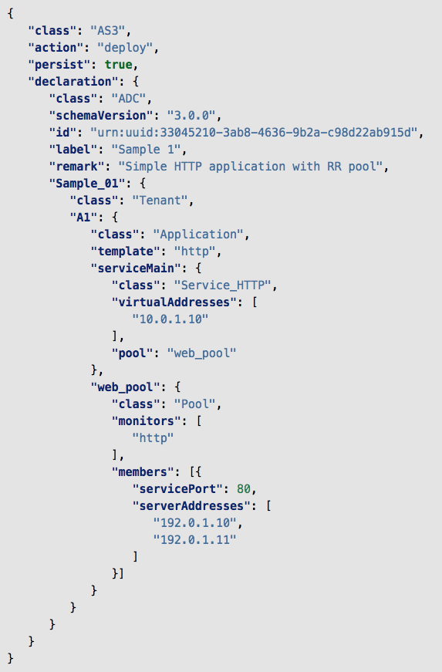



Zero Touch Application Delivery with F5 and Hashicorp
Example Declarations
Onboard
Deploy App Services
Monitoring/Telemetry
APP SERVICES 3 EXTENSION
TELEMETRY STREAMING EXTENSION
Deploy Classic and Advanced Application Services on BIG-IP using Declarative REST APIs
Stream Telemetry, Events & Logs from BIG-IP to various Analytics and Logging solutions
L1-L3
L4-L7
Notes:
A new set of tools - bolt on to f5.
The training is not exclusively F5. It includes labs on many aspects of automation including a really nice 101 on Hashicorp Terraform.

Slide 16
What is the App Services 3 Extension (AS3)?
TMOS independent RPM package installed on BIG-IP*
Provides a single declarative REST API endpoint…
https://big-ip/mgmt/shared/appsvcs/declare
Interface for common L4-7 app service use cases
Atomic and idempotent
Multi-tenant
Accepts a single JSON document
Omitted values assume defaults
Guaranteed to be backward compatible
Requires TMOS 12.1+
Available now: https://github.com/F5Networks/f5-appsvcs-extension
Free & supported by F5

Slide 17
What you can and can’t do with AS3?
LTM (LB & L7 Full Proxy) 75% coverage
ASM (WAF) – apply existing policy (can be downloaded from repo)
APM (IAM) - apply existing policy (can be downloaded from repo)
AFM (FW) – Firewall policies and auto-discovery
DNS - basic GSLB

Slide 18
Automation Toolchain Within Customer Ecosystem
Management & Ecosystem Solutions
Source of Truth
Declarative - Tell the system WHAT you would like to happen and let it figure out HOW to do it
F5 Automation Toolchain (Declarative API)
Imperative - Tell the system HOW to do something and as a result WHAT you want to happen
F5 iControl REST (Imperative API)
Notes:
Imperative: HOW to reach a desired end-state
Step-by-step specific & ordered instructions
Requires domain-specific knowledge
Maximizes flexibility at the cost of extra complexity
Infinite deployment options
Not reusable in many cases
Usually not idempotent
Attractive to NetOps
Declarative: WHAT the end state needs to be
Single step instruction
Minimizes need for domain-specific knowledge
Reduced flexibility and reduced complexity
Finite packaged deployment options
JSON document approach enables reusability
Easier to make idempotent
Attractive to DevOps
AS3:
Abstracts away all aspects of BIG-IP L4-L7 configuration
Eliminates need for BIG-IP domain expertise
Speeds BIG-IP app service deployments
Reduces risks and errors
Enables consistency via easy deployment replication
Reduces integration coding costs
Spend more time writing apps, not integrations

Slide 19
Automation Without AS3
Multiple Imperative Commands
Management &
Ecosystem Solutions
F5 BIG-IP
iControl REST (Imperative API)
Notes:
Requires BIG-IP domain expertise
Dozens of REST API calls
Costly to automate and integrate with orchestration systems
Time-consuming
Error-prone

Slide 20
Automation With AS3
Single Declarative Statement
Multiple Imperative Commands
Management &
Ecosystem Solutions
F5 Automation Toolchain (Declarative API)
F5 BIG-IP
iControl REST (Imperative API)
Notes:
AS3 abstracts away all BIG-IP configuration complexity
User only needs to define the desired configuration end-state
Requires no BIG-IP domain expertise
Single REST API call simplifies automation and orchestrator integrations
Accelerates app service deployment
Declaration is reusable, ensures consistency, reduces errors

Slide 21





AS3 Everywhere – Consistent API
Service
Discovery
AS3
AS3
AS3
AS3
AS3
BIG-IP Platform
BIG-IP
Virtual Edition
BIG-IP Platform
BIG-IP
Virtual Edition
BIG-IP
Virtual Edition
BIG-IP SSG
Summer 2018
Autumn 2018
Q3 2019
On BIG-IP
In Public Cloud +
Service Discovery
In Container
On BIG-IQ

Slide 22
Telemetry Streaming

Slide 23



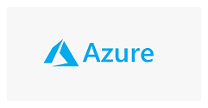






Telemetry Streaming
AS3 consistent configuration in.
DC
Telemetry streaming consistent data out
(Operational & Security)

Slide 24
Automation Workflow Examples

Slide 25

Workflow Example 0.1
Learning about declarative onboarding and AS3 automation of BIG-IP.
REST API Calls
Collections
Physical Appliance / Chassis
Runner
Virtual Edition
Automated Tests
Cloud Edition / Blue
API Dev Tool
TF5 Platform
BIG-IP
+ AS3 + DO
Notes:
DO FAQ (internal): https://hive.f5.com/docs/DOC-49381
AS3 Docs: https://clouddocs.f5.com/products/extensions/f5-appsvcs-extension/latest/
Intro to A&O Lab Guide: https://clouddocs.f5.com/training/community/programmability/html/class1/class1.html

Slide 26
Workflow Example 0.2
AS3 deployment via the BIG-IQ AS3 proxy to leverage BIG-IQ Analytics.
REST API Calls
HTTP Simple
Collections
HTTPS Advanced
Physical Appliance / Chassis
Runner
Application Security
Virtual Edition
Automated Tests
Analytics
Cloud Edition / Blue
API Dev Tool
App Services
TF5 Platform
BIG-IQ
+ AS3
BIG-IP
+ AS3 + DO

Slide 27

Workflow Example 1
Configuration Management using Ansible Tower
Deployment Playbooks
Input Forms (Survey)
HTTP Simple
RBAC
HTTPS Advanced
Physical Appliance / Chassis
Job Scheduling
Application Security
Virtual Edition
Logging & Reporting
Analytics
Cloud Edition / Blue
Orchestration
App Services
TF5 Platform
BIG-IQ
+ AS3
BIG-IP
+ AS3 + DO

Slide 28
Workflow Example 2
Infrastructure as Code using a Source Code Management tool
Deployment Playbooks
Input Forms (Survey)
HTTP Simple
Source Code Repo - IaC
RBAC
HTTPS Advanced
Physical Appliance / Chassis
Revision Control
Job Scheduling
Application Security
Virtual Edition
Webhook
Logging & Reporting
Analytics
Cloud Edition / Blue
SCM
Orchestration
App Services
TF5 Platform
BIG-IQ
+ AS3
BIG-IP
+ AS3 + DO

Slide 29
Workflow Example 2
Infrastructure as Code using a Source Code Management tool
Deployment Playbooks
Input Forms (Survey)
HTTP Simple
Source Code Repo - IaC
RBAC
HTTPS Advanced
Physical Appliance / Chassis
Revision Control
Job Scheduling
Application Security
Virtual Edition
Webhook
Logging & Reporting
Analytics
Cloud Edition / Blue
SCM
Orchestration
App Services
TF5 Platform
BIG-IQ
+ AS3
BIG-IP
+ AS3 + DO

Slide 30
Workflow Example 3
Self-service provisioning via a service catalogue.
Deployment Playbooks
Input Forms (Survey)
HTTP Simple
Request Form
Source Code Repo - IaC
RBAC
HTTPS Advanced
Physical Appliance / Chassis
Workflow Approvals
Revision Control
Job Scheduling
Application Security
Virtual Edition
Create Config
Webhook
Logging & Reporting
Analytics
Cloud Edition / Blue
Service Catalogue
SCM
Orchestration
App Services
TF5 Platform
BIG-IQ
+ AS3
BIG-IP
+ AS3 + DO

Slide 31
Workflow Example 4
Automated staging and testing before deploying to production
Deployment Playbooks
Physical Appliance / Chassis
Input Forms (Survey)
HTTP Simple
Virtual Edition
Request Form
Source Code Repo - IaC
RBAC
HTTPS Advanced
Cloud Edition / Blue
Workflow Approvals
Revision Control
Job Scheduling
Application Security
TF5 Platform
Create Config
Webhook
Logging & Reporting
Analytics
Service Catalogue
SCM
App Services
BIG-IP + AS3
(DEV)
Orchestration
BIG-IQ
+ AS3
BIG-IP + AS3
(UAT)
BIG-IP + AS3
(PROD)

Slide 32


Workflow Example 5
DevOps CI/CD pipeline integration
Deployment Playbooks
Physical Appliance / Chassis
Input Forms (Survey)
HTTP Simple
Virtual Edition
Request Form
Source Code Repo - IaC
RBAC
HTTPS Advanced
Cloud Edition / Blue
Workflow Approvals
Revision Control
Job Scheduling
Application Security
TF5 Platform
Create Config
Webhook
Logging & Reporting
Analytics
Service Catalogue
SCM
App Services
BIG-IP + AS3
(DEV)
Orchestration
BIG-IQ
+ AS3
BIG-IP + AS3
(UAT)
BIG-IP + AS3
(PROD)

Slide 33
Automation & Orchestration Plan
L1-L3
L4-L7
No
Automation
MGMT
More Complex
Higher TCO
WebUI / CLI
iApps
BIG-IQ
Controller
F5 Portal
Templates
Application
Architecture
Service Scaling
AS3
Declarative Onboarding
Container Services
CY19
Automation Ecosystem (e.g SNOW)
Full
Automation
Less Complex /
Cloud Native
BIG-IP
HW
BIG-IP
VE
Cloud Edition
Cloud Native App Services
F5aaS
0% ~10%
100%
Applications

Slide 34
AS3 Declaration

Slide 35
AS3 Methods
The AS3 API supports Create, Read, Update, and Delete (CRUD) actions…
Remove data for one or more tenants.
If no tenant specified, the entire AS3 configuration is removed.
DELETE
POST
Deploy configuration;
Actions:
deploy
dry-run
patch
redeploy
retrieve
remove
GET
Modify existing declaration:
add
remove
replace
move
copy
Retrieve previous declaration.
Select the data you want by appending to the AS3 path.
PATCH

Slide 36
AS3 JSON Schema
The simplest representation of an AS3 declaration…
AS3 Class
Controls AS3 execution
ADC Class
Controls ADC-Centric Attributes
Tenant Class
Tenant
Maps to BIG-IP Partitions
Application Class
Application
Application
Maps to BIG-IP Folders in Partition
Service Class
Service
Maps to BIG-IP Virtual Servers
Service
Service
Pool Class
iRule Class
HTTP_Profile Class
Map to BIG-IP Objects
Pool
Pool

Slide 37
AS3 Sample Declaration
{
"class": "AS3",
"action": "deploy",
"persist": true,
"declaration": {
"class": "ADC",
"schemaVersion": "3.0.0",
"id": "example-declaration-01",
"label": "Sample 1",
"remark": "Simple HTTP application with round robin pool",
"updateMode": "selective",
"Sample_01": {
"class": "Tenant",
"defaultRouteDomain": 0,
"Application_1": {
"class": "Application",
"template": "http",
"serviceMain": {
"class": "Service_HTTP",
"virtualAddresses": [
"10.0.1.10"
],
"pool": "web_pool"
},
"web_pool": {
"class": "Pool",
"monitors": [
"http"
],
"members": [
{
"servicePort": 80,
"serverAddresses": [
"192.0.1.10",
"192.0.1.11"
]
}
]
}
}
}
}
}
Create a simple HTTP application service:
HTTP Virtual Server
Pool named web_pool with 2 members
Monitored by default HTTP health monitor
Partition (tenant) named Sample_01
Declaration not ordered, nor sequenced
POST this JSON text to AS3 at:
/mgmt/shared/appsvcs/declare
That’s it!

Slide 38
AS3 Sample Declaration
{
"firewallPolicy": {
"class": "Firewall_Policy",
"remark": "A firewall policy",
"rules": [{
"use": "ruleList"
}]
},
"ruleList": {
"class": "Firewall_Rule_List",
"remark": "A firewall rule list",
"rules": [{
"name": "rule",
"remark": "A firewall rule list rule",
"action": "drop",
"protocol": "tcp",
"source": {
"addressLists": [{
"use": "addressList"
}]
},
"loggingEnabled": true
}]
},
"addressList": {
"class": "Firewall_Address_List",
"remark": "A firewall address list",
"addresses": [{
"servicePort": 80,
"addressDiscovery": "aws",
"updateInterval": 10,
"tagKey": "application",
"tagValue": "prod",
"addressRealm": "private",
"region": "ap-southeast-2",
"accessKeyId": ”XxXxX",
"secretAccessKey": ”XxXxX",
"credentialUpdate": false
}]
}
}
Add entries to a firewall rule based on AWS tags.
Instance tags.
Added and removed automatically
Declaration not ordered, nor sequenced
POST this JSON text to AS3 at:
/mgmt/shared/appsvcs/declare
That’s it!

Slide 39
AS3 Sample Declaration
{
"class": "AS3",
"action": "deploy",
"persist": true,
"declaration": {
"class": "ADC",
"schemaVersion": "3.0.0",
"id": "example-declaration-01",
"target": {"address": "10.1.2.3"},
"remark": "Simple HTTP application with round robin pool",
"updateMode": "selective",
"Sample_01": {
"class": "Tenant",
"defaultRouteDomain": 0,
"Application_1": {
"class": "Application",
"template": "http",
"serviceMain": {
"class": "Service_HTTP",
"virtualAddresses": [
"10.0.1.10"
],
"pool": "web_pool"
},
"web_pool": {
"class": "Pool",
"monitors": [
"http"
],
"members": [
{
"servicePort": 80,
"serverAddresses": [
"192.0.1.10",
"192.0.1.11"
]
}
]
}
}
}
}
}
The AS3 Class
class: AS3 # mandatory
action: deploy, dry-run, redeploy, retrieve, remove
persist: true, false
The ADC Class
class : ADC # mandatory
schemaVersion: 3.0.0, 3.1.0, 3.2.0
Id: arbitrary (suggest using urn::uuid)
Label: arbitrary (labels the declaration)
updateMode: complete, selective
target: Destination IP, via docker / BIG-IQ
#optional
IMPORTANT
This will remove all tenants that AS3 has created
…and replace with this declaration.
The Tenant Class
Sample_01: Tenant name i.e. BIG-IP partition name
class: Tenant # mandatory
defaultRouteDomain: number

Slide 40
AS3 Sample Declaration
{
"class": "AS3",
"action": "deploy",
"persist": true,
"declaration": {
"class": "ADC",
"schemaVersion": "3.0.0",
"id": "example-declaration-01",
"label": "Sample 1",
"remark": "Simple HTTP application with round robin pool",
"updateMode": "selective",
"Sample_01": {
"class": "Tenant",
"defaultRouteDomain": 0,
"A1": {
"class": "Application",
"template": "http",
"serviceMain": {
"class": "Service_HTTP",
"virtualAddresses": [
"10.0.1.10"
],
"pool": "web_pool"
},
"web_pool": {
"class": "Pool",
"monitors": [
"http"
],
"members": [
{
"servicePort": 80,
"serverAddresses": [
"192.0.1.10",
"192.0.1.11"
]
}
]
}
}
}
}
}
Generic: Doesn’t enforce required objects.
Allows you to rename serviceMain
Shared: Holds objects other applications can use
Aside from ‘generic’ and ‘shared’, values for template and virtualAddresses must correlate.
The Application Class
A1: The application name = TMSH folder in partition.
class: Application # mandatory
template: http, https, tcp, udp, l4, generic, shared
The Service Class
class: Service_HTTP, Service_HTTPS,
Service_TCP, Service_UDP, Service_L4,
generic, shared
virtualAddresses: IP Address
The Pool Class
web_pool: Defines the name of the pool
class: pool # mandatory
monitors: not mandatory, but highly recommended!
members: servicePort, serverAddresses # if serviePort
is not included, it will choose a default
related to the template e.g. http = 80

Slide 41
AS3 Sample Declaration
{
"class": "AS3",
"action": "deploy",
"persist": true,
"declaration": {
"class": "ADC",
"schemaVersion": "3.0.0",
"id": "example-declaration-01",
"label": "Sample 1",
"remark": "Simple HTTP application with round robin pool",
"updateMode": "selective",
"Sample_01": {
"class": "Tenant",
"defaultRouteDomain": 0,
"A1": {
"class": "Application",
"my_virtual": {
"class": "Service_HTTP",
"virtualAddresses": [
"10.0.1.10"
],
"pool": "web_pool"
},
"web_pool": {
"class": "Pool",
"monitors": [
"http"
],
"members": [
{
"servicePort": 80,
"serverAddresses": [
"192.0.1.10",
"192.0.1.11"
]
}
]
}
}
}
}
}
The Application Class
A1: The application name = TMSH folder in partition.
class: Application # mandatory
The Service Class
class: Service_HTTP, Service_HTTPS,
Service_TCP, Service_UDP, Service_L4,
generic, shared
virtualAddresses: IP Address
The Pool Class
web_pool: Defines the name of the pool
class: pool # mandatory
monitors: not mandatory, but highly recommended!
members: servicePort, serverAddresses # if serviePort
is not included, it will choose a default
related to the template e.g. http = 80

Slide 42
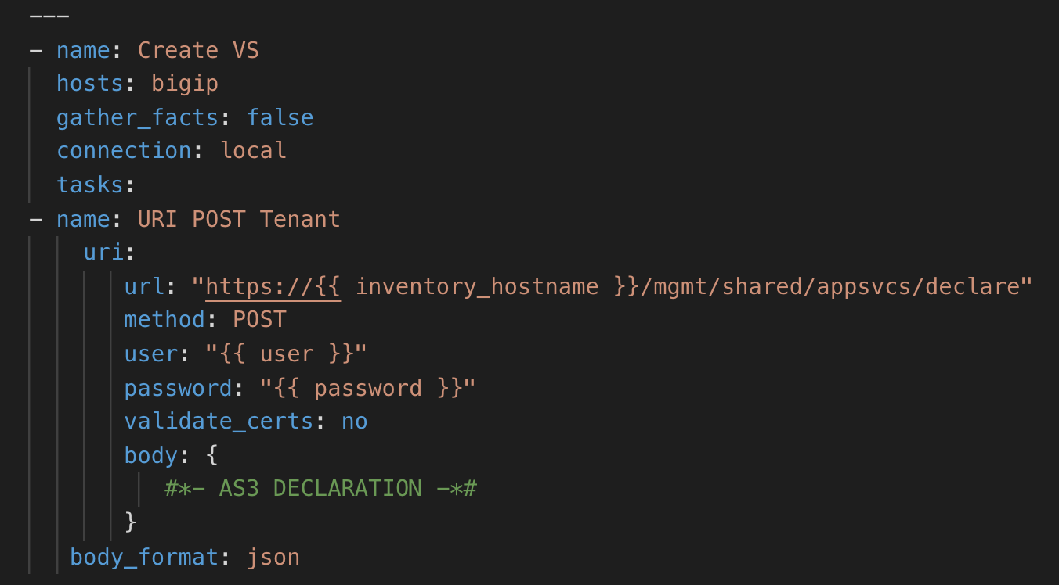
AS3 Sample Ansible Playbook
AS3 Sample Ansible Playbook

Slide 43

F5 Super-NetOps Training
https://f5.com/education/super-netops-training

Slide 44
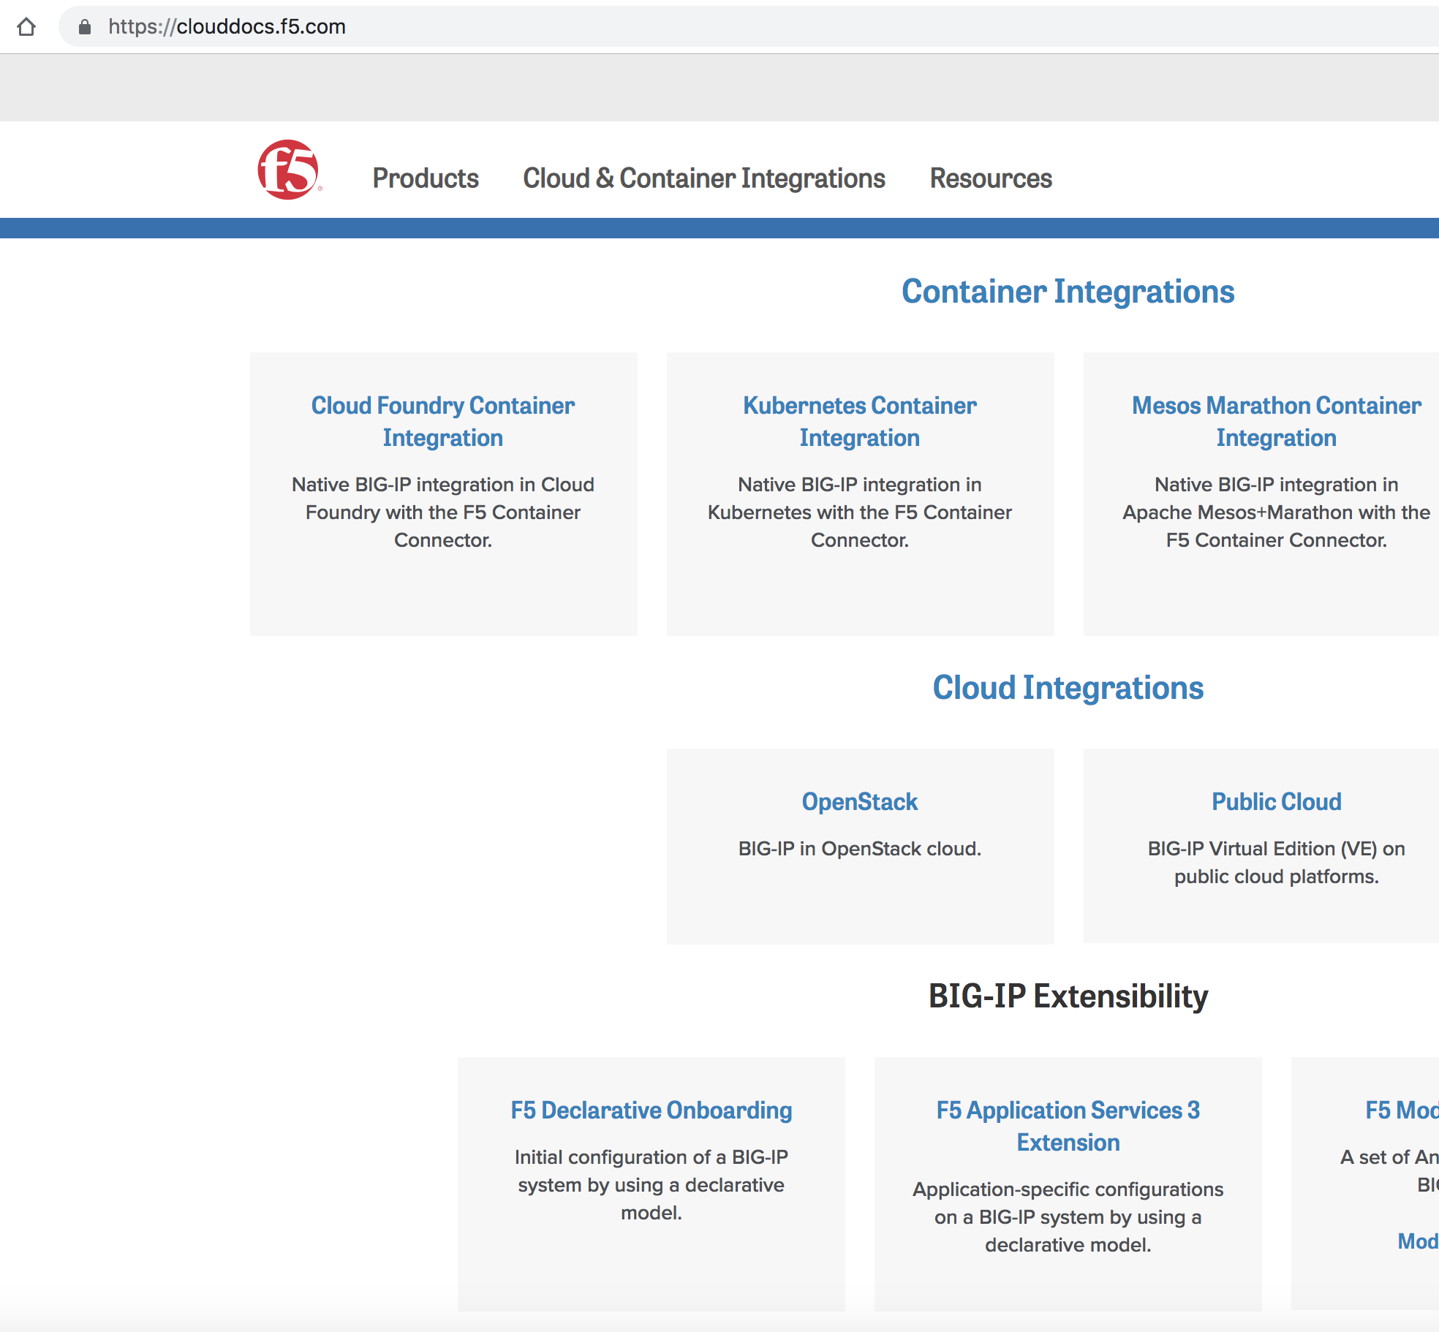
AS3 Documentation
https://clouddocs.f5.com

Slide 45
```
Notes:
Early examples of automation: routing protocols, SNMP polls/traps, telnet/expect scripts.

Slide 46
Demo

